Slide 1
Chest Tube
By
A.L. Maher Abdul Ameer

Slide 3
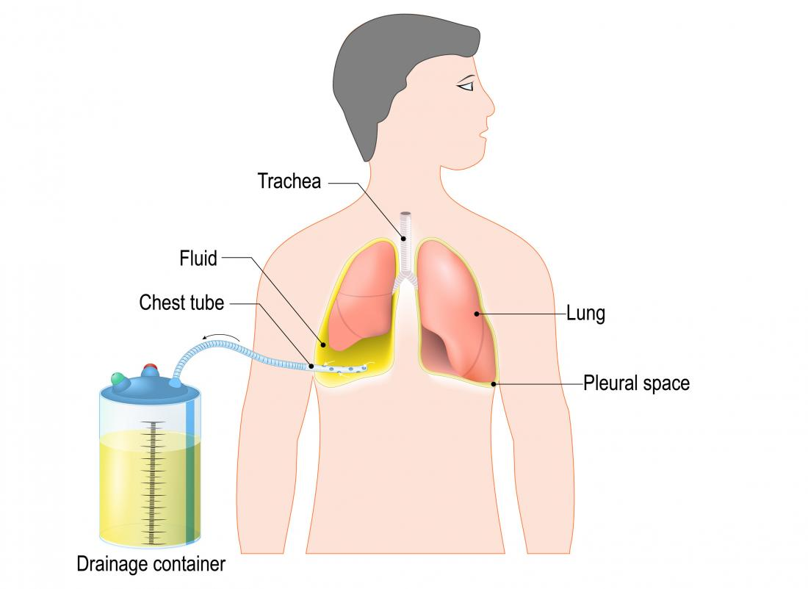

Slide 5
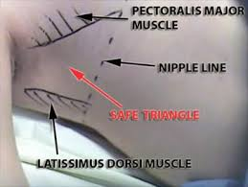
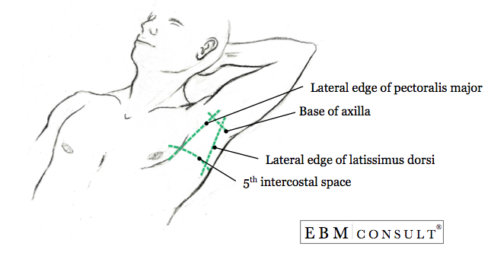
Chest tube
a hollow plastic tube is inserted between ribs into the pleural space. The tube may be connected to a machine to help with the drainage. The tube will stay in place until the fluid, blood, or air is drained from the chest.

Slide 6
Indications
Fluid
Pleural Effusion
Air
Pneumothorax
Blood
Pus
Serous Fluid

Slide 7
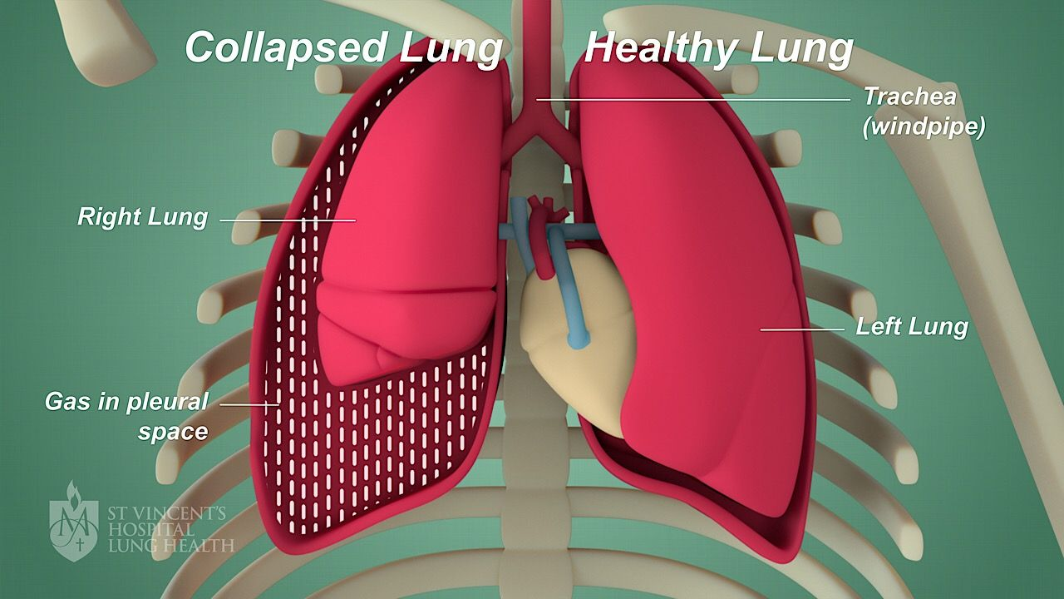
Pneumothorax

Slide 8
Pleural Effusion
Pus
Blood
Serous
Fluid
Empyema
Hemothorax
Hydrothorax

Slide 9
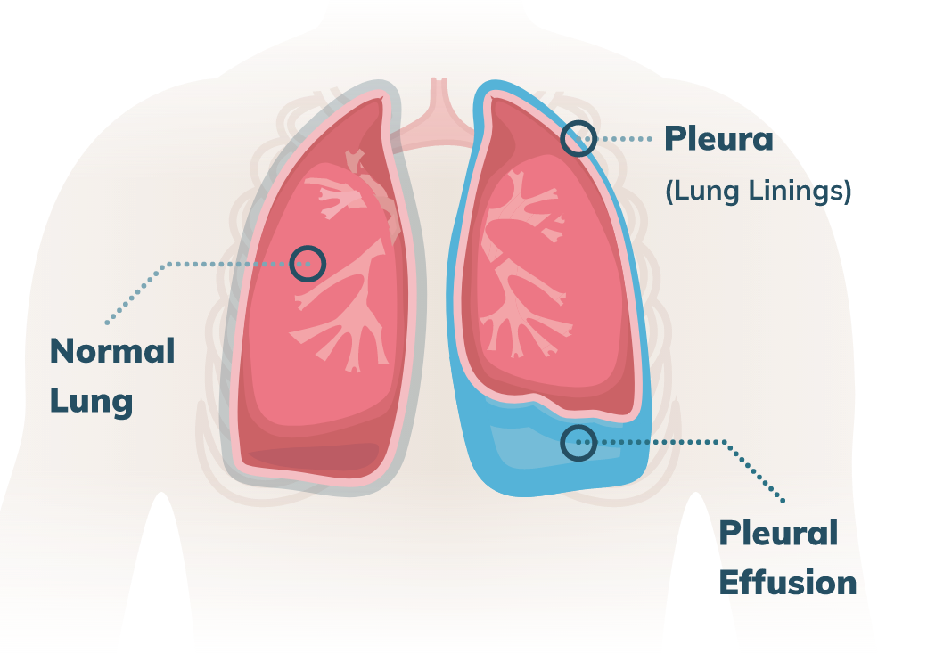
Pleural effusion

Slide 12
Purposes
To remove fluid or air from the pleural space
To promote lung re- expantion

Slide 13
Equipment
Sterile gloves and gown.
Skin antiseptic solution (e.g. iodine or 2% chlorhexidine in 70% alcohol)
Sterile drapes.
Gauze swabs.
A selection of syringes and needles (19-25 gauge in adults)
Local anesthetic (e.g. lignocaine 1%)
Scalpel and blade.
Suture kit: Suture (stout and non-absorbable /1.0 - 2.0 silk or prolene)
An instrument for blunt dissection if required (curved clamp)
Guidewire and dilators for Seldinger technique
Chest tube
Connecting tube
Closed drainage system (under water seal)
Dressing equipment may also be available in a kit form
Chest tube clamps

Slide 14
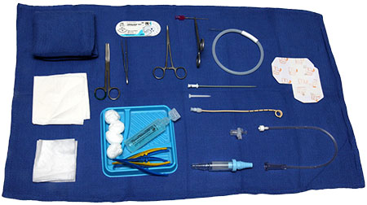
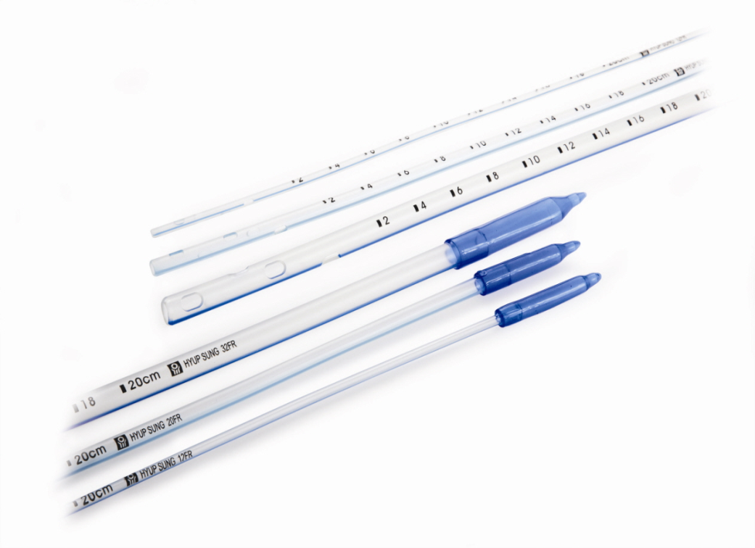
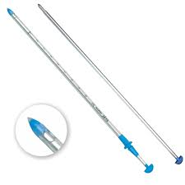
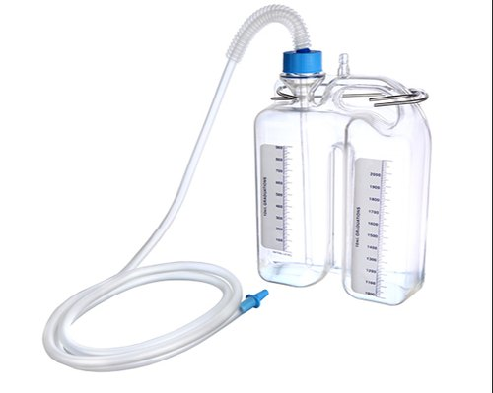
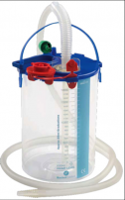

Slide 15
Preparation for under water seal bottle
Put 250-500 ml according hospital policy
(Avoid tension pneumothorax)
Tube submerged approximately 2cm under water
Bottle should be chest level (gravity- no backflow)

Slide 17
Nursing role before insertion chest tube
Identify PT
Explain procedures
Hand washing
Vital sings
Prepare the chest tube tray
Administration mild sedation if ordered

Slide 18
PROCEDURE

Slide 19
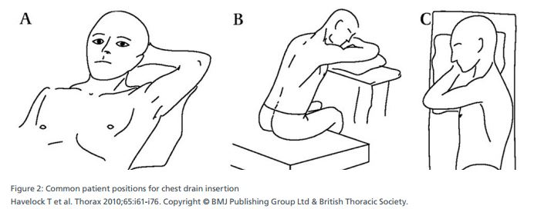
Patient positions

Slide 20
Elevating the head of a person’s bed by 30–60 degrees. Identifying the tube insertion site. This will typically be between the fourth and fifth ribs or between the fifth and sixth ribs, just behind the pectoralis (chest) muscle.
Cleaning the skin with a solution, such as povidone-iodine or chlorhexidine.
Using local anesthetic to numb the insertion site.
Making an incision of about 2–3 centimeters (cm) through the skin. Using a surgical instrument called a Kelly clamp, widen the incision and gain access to the pleural space. The clamp insertion should be slow to avoid puncturing the lung.

Slide 21
Inserting a gloved finger into the incision site. This is to confirm that the area is the pleural space.
Inserting the chest tube through the incision site. If fluid begins to drain through the tube, it is in the right place. It is also possible to attach the tube to a chamber containing water that moves when a person breathes. If this does not occur, the tube may need repositioning.
Suturing the tube in place so that the seal is as airtight as possible.
Covering the tube insertion site with gauze pads.

Slide 22
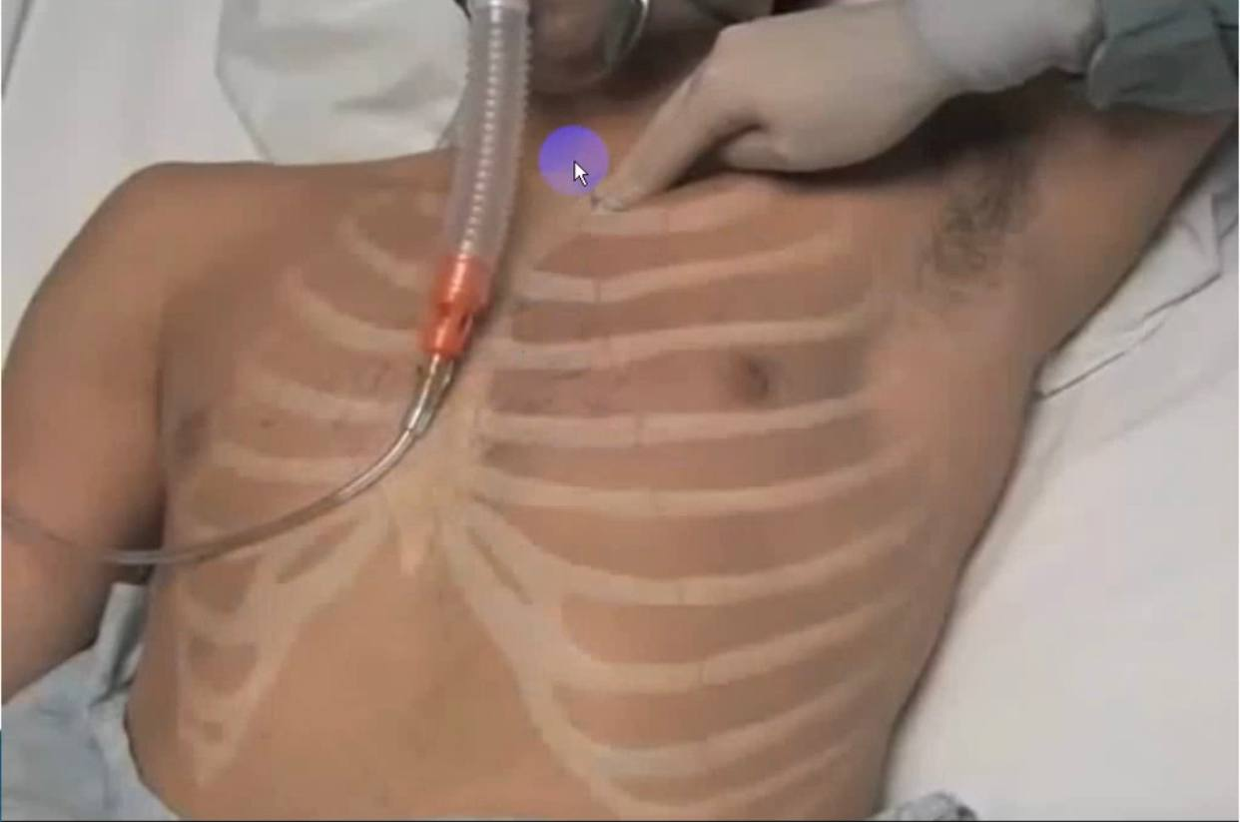

Slide 23
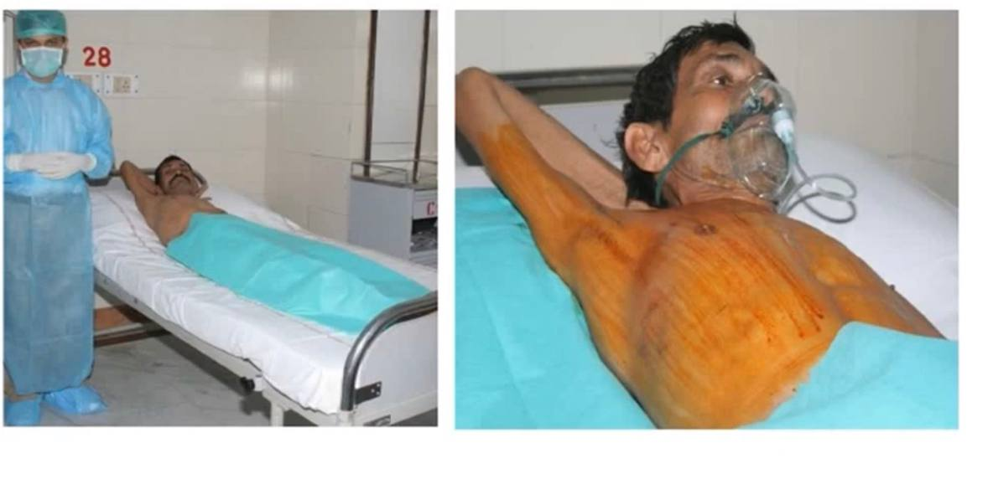

Slide 24
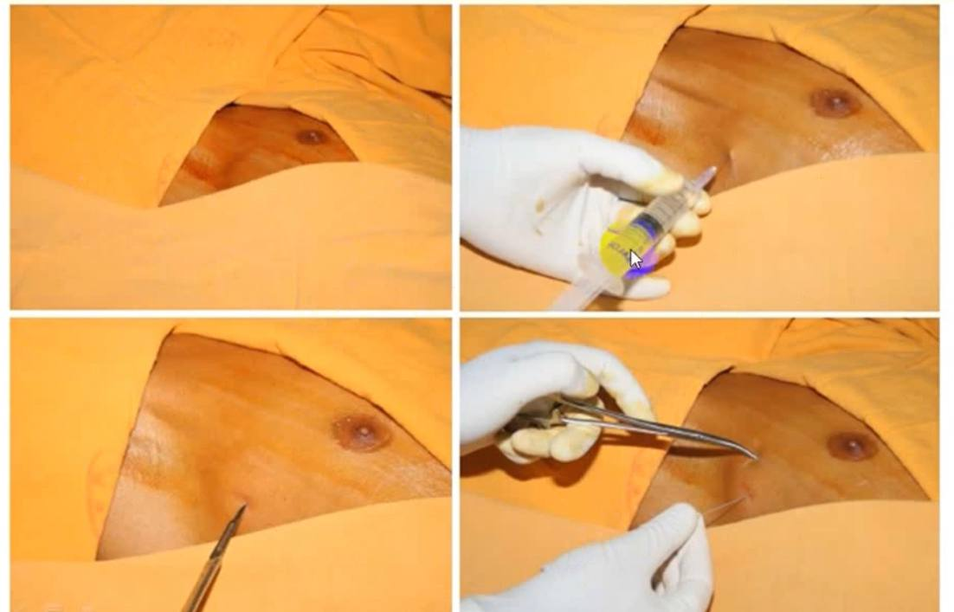

Slide 25
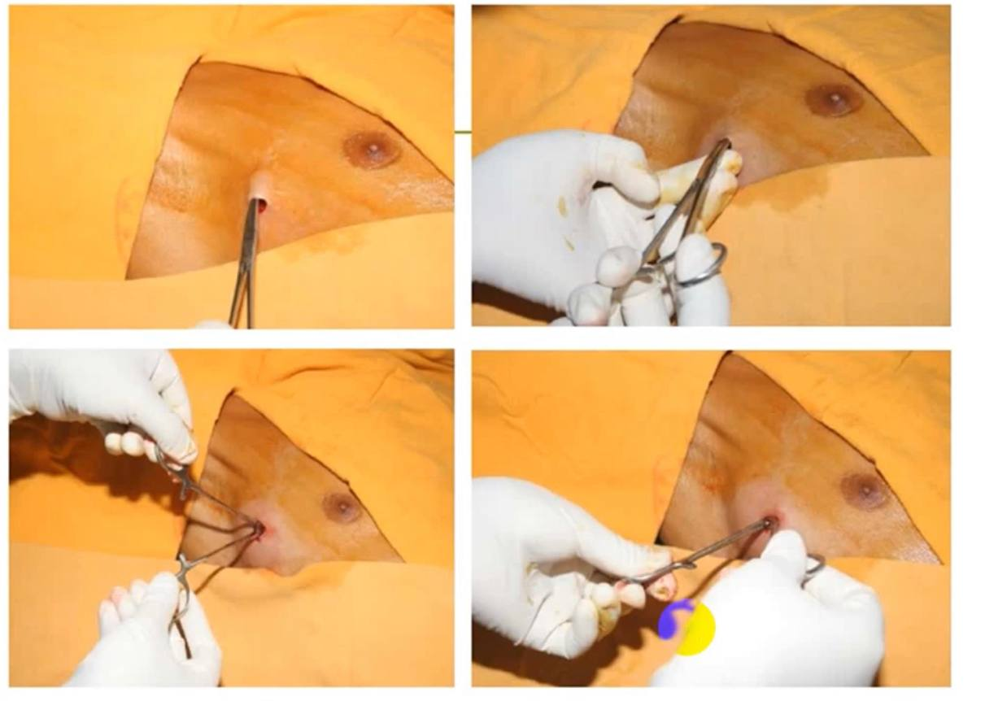

Slide 26
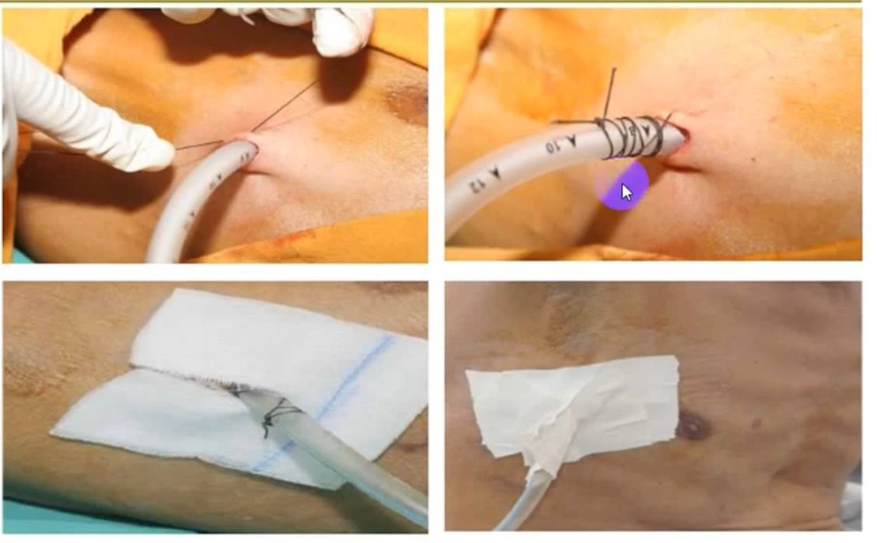

Slide 27
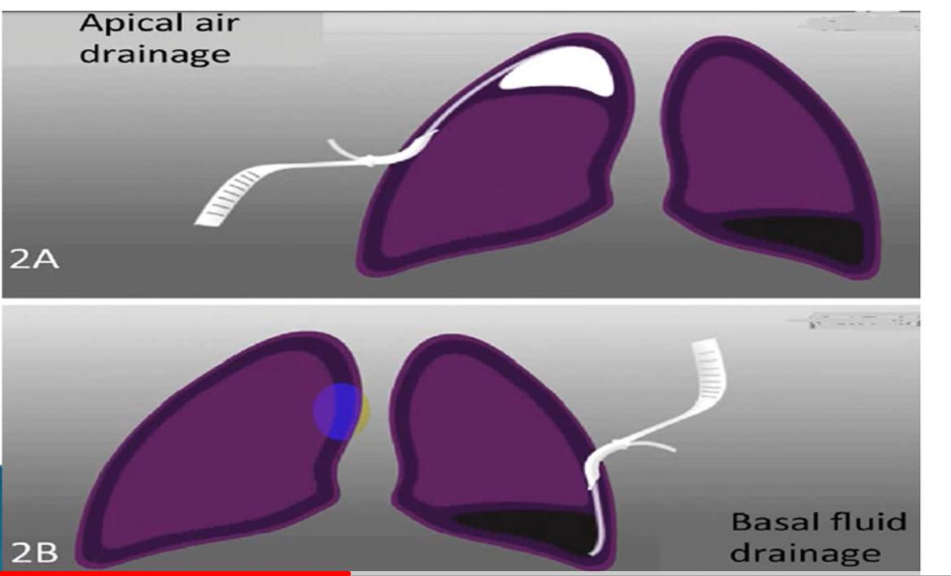
Apical and basal insertion mid axillary line equal 5 intercostal space

Slide 28
Care of patient with chest tube
Assess vital signs
Set up drainage system as ordered
Auscultate lung sound

Slide 30
Inspect all tubing for leaks
Keep chest tube below level of chest
In the event of disconnection, 2 clamps should be kept at bedside
Encourage the pt to cough and deep breathing
Keep large clamps bedside when empty or replace abroken or checked bottle system
Check fluctuation (effusion) and bubbling (pneumothorax)

Slide 31
Daily care for patients with chest tube
1. Patient activity
Semi- fowler position is required
Turn the PT every 2 hrs
PT can be out of bed if there is no contraindication
Do exercises to the affected arm and shoulder
Encourage coughing and deep breathing

Slide 32
2. Clamping
Changing the bottle
Tubing is disconnected and sterile water is out of reach
If changing the position and when elevating the tube system above the PT level is required
Do not clamping: ambulating a patient

Slide 33
3. Milking
Milking the tube is not recommended, creates tissue trauma

Slide 34
Complications
Malposition( organ perforation)
Recurrent pneumothorax
Infection (including empyema)
Tube blockage
Hemorrhage
Subcutaneous emphysema

Slide 35
Don’t be afraid to fail
Just keep trying

Slide 36
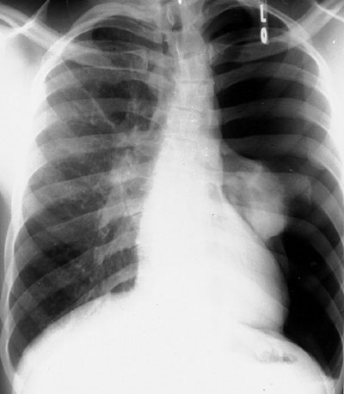
CHECK IT

